Slide 1

Food Security Strategies
for a Changing World
Christopher B. Barrett
Cornell University
Seminar at World Food System Center
ETH Zurich
June 8, 2022

Slide 2
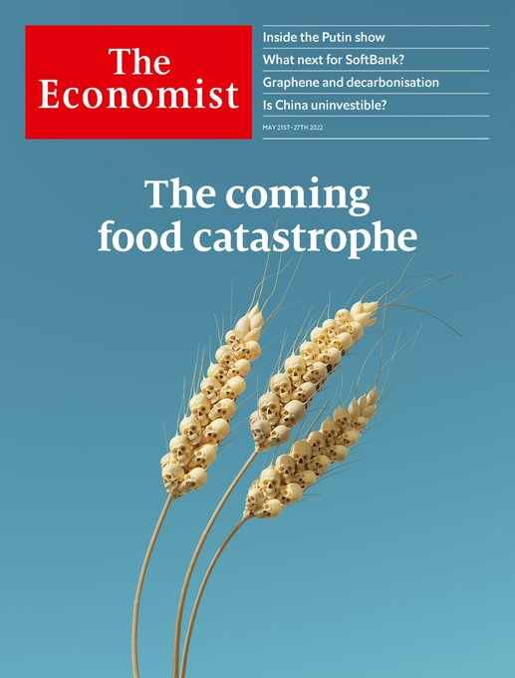
A coming food catastrophe?
Is there a looming “food catastrophe”?
Short-run ‘C3’: conflict, COVID, climate
Long-run:
1. Population and income growth
demand growth
2. Land/water constraints + climate change + slowing productivity growth
headwinds for supply growth
Beware scaremongering. Humans notice headwinds not tailwinds.

Slide 3
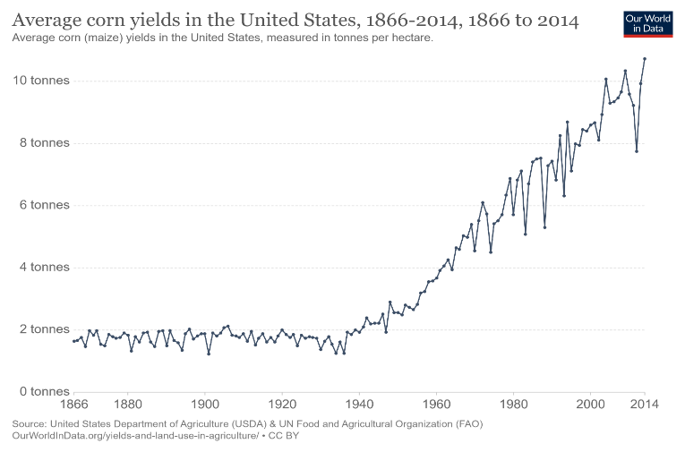
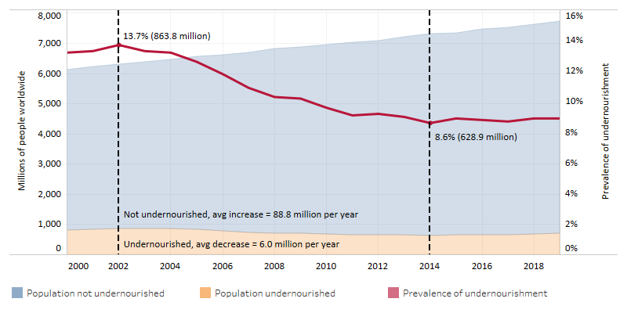


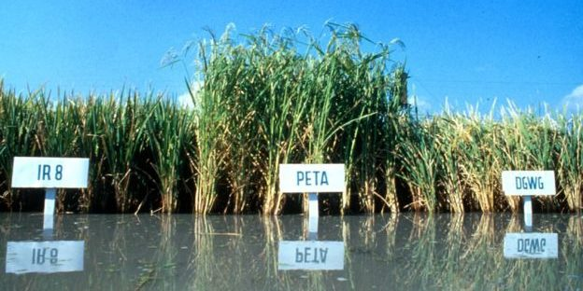
Formidable but manageable
These challenges are formidable but manageable
The world has previously overcome global food security challenges w/scientific and social protection innovations.
We can prevail again IFF we follow a progressive strategy: trust in science to enable progress + show solidarity w/poor.
Must define the task(s) correctly. It’s no longer hunger and yields.
Data: FAO, Our World in Data
Photo credits: Forward Press, IRRI, Edesia

Slide 4
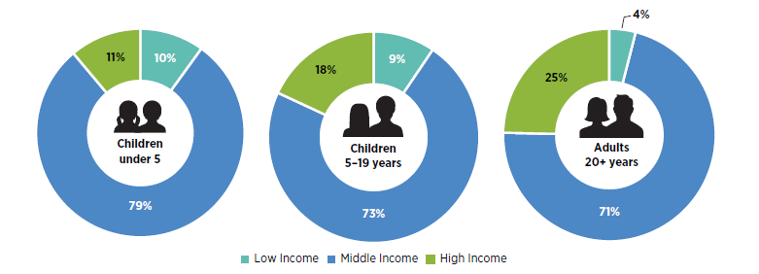
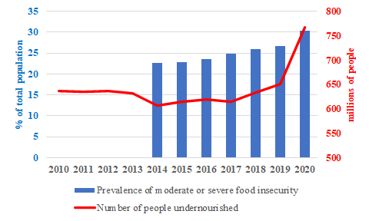
Success w/major, unintended consequences
%world’s overweight/obese population
Dramatic success in reducing hunger … but
- 2 bn people are obese/overweight
- >2.5 bn are micronutrient deficient
- 70% of water withdrawals are ag and rising (esp in Asia/Africa).
- Ag accounts f0r 24% of GHG emissions but could be a net sink for C and N (IPCC 2014).
- Progress on food security is stalling, even reversing.
Data source: FAOStat

Slide 5
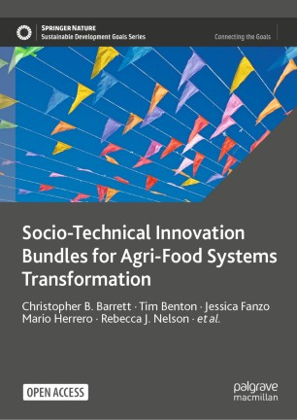
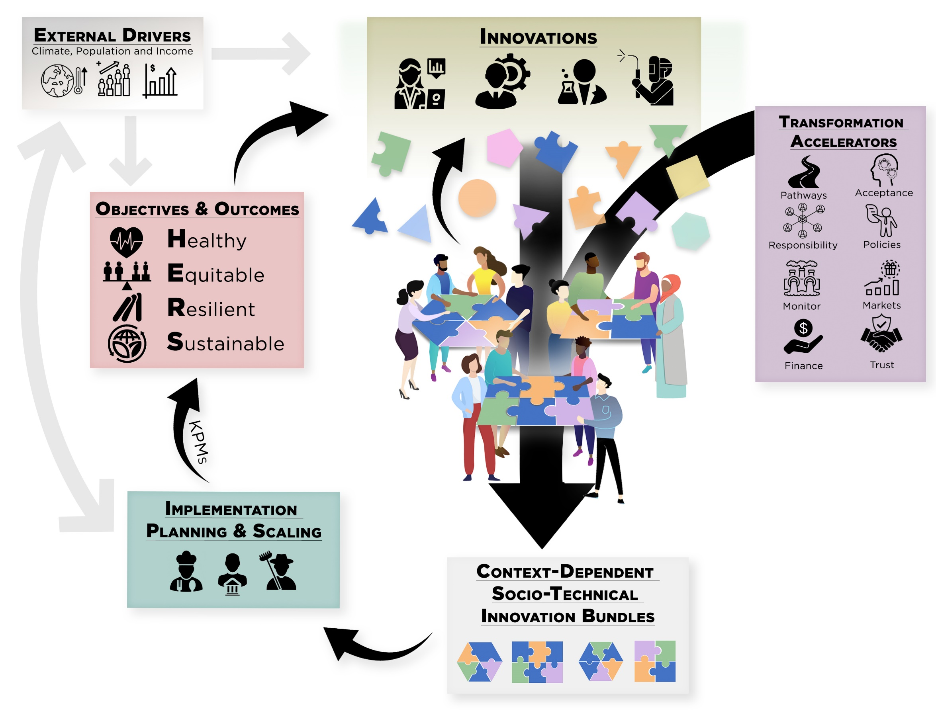
Must update objectives
The challenges ahead differ from those 50-90 yrs ago. Innovation objectives, strategies, metrics must too.
We must embrace/advance multiple objectives simultaneously.
Build around a shared vision of HERS agri-food systems (AFS).
And recognize that progress requires bundled innovations.

Slide 6
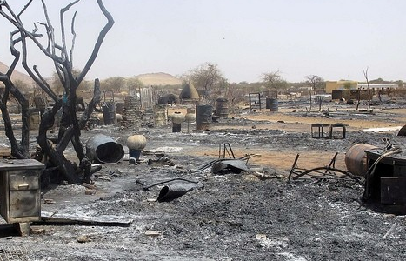
Conflict reduction and social protection are key
Undernourishment/hunger again a growing problem
… entirely due to conflict.
The root cause of hunger is poverty. And the greatest cause of mass, rapid impoverishment is violence.
Conflict-affected nations’ share of stunted children >75% (FAO et al. 2017) vs. <20% of all children. 13/15 nations WFP declares as facing food emergencies suffer serious conflict! >85 mn forcibly displaced.
Combatting hunger is now a governance, conflict resolution, and social protection task. No longer an AFS issue.
Photo credit: Radio Dabanga (Darfur)

Slide 7
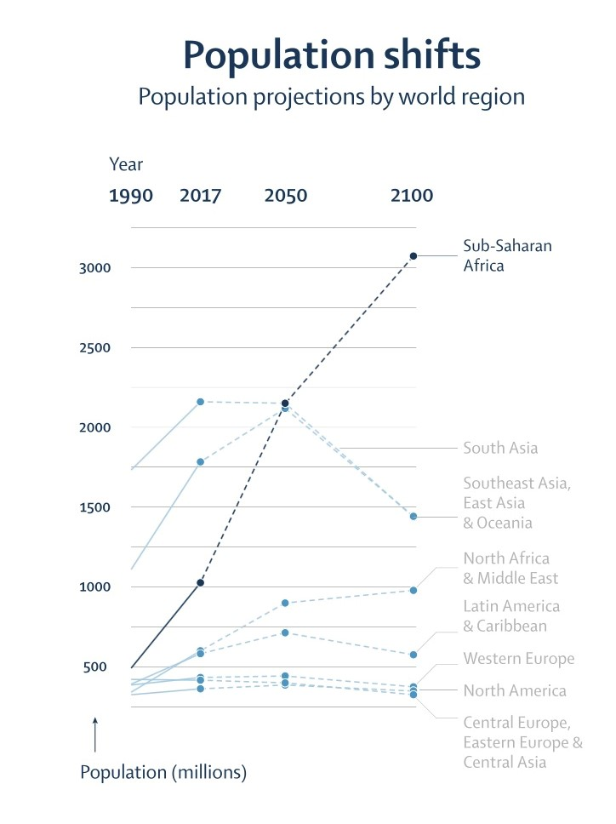
>70% global food demand growth to 2100
Pay more attention to Africa
Global pop will peak in 2060s
But Africa will grow, from >1bn today to >3bn. Asia falls from >4 bn today to <3 bn in 2100. ~ All net global pop growth at 2100 in Africa.
Africa urbanizing fastest.
Economies will grow > world avg. and income elasticities of food demand highest in Africa.
70-80% of food consumed w/n country where grown.
Must build capacity within Africa to combat food security challenges!
Source: Vollset et al. Lancet 2020

Slide 8
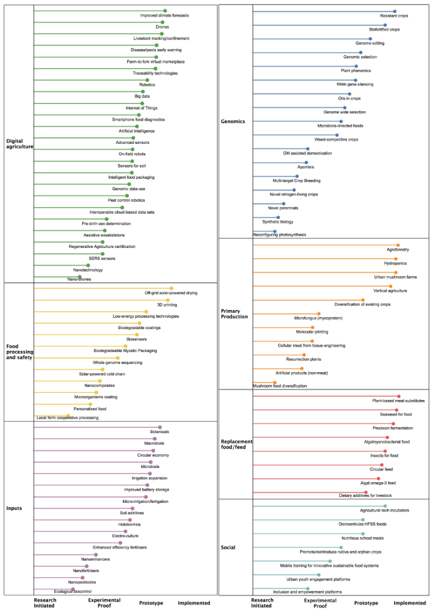
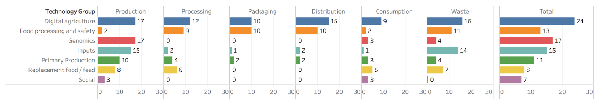
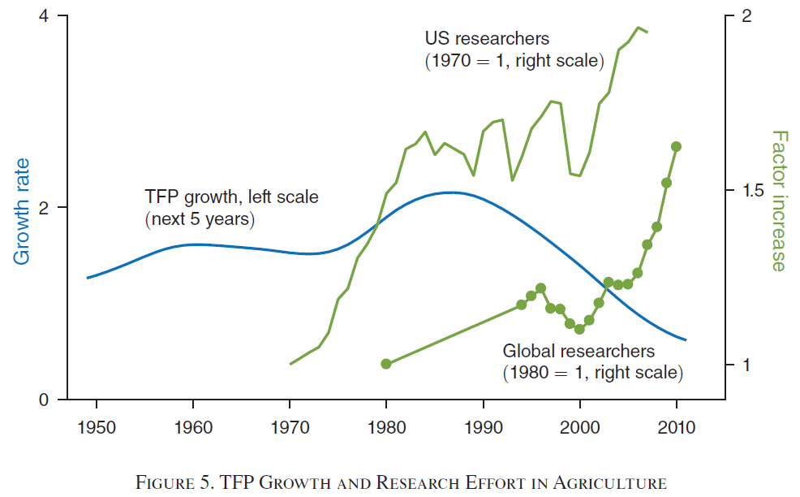
Ample STI in pipeline
Many promising (natural/social) science advances of variable deployment readiness. Span value chains and geographies.
Despite declining ag R&D productivity: -4-6%/yr
(Bloom et al. AER 2020)

Slide 9
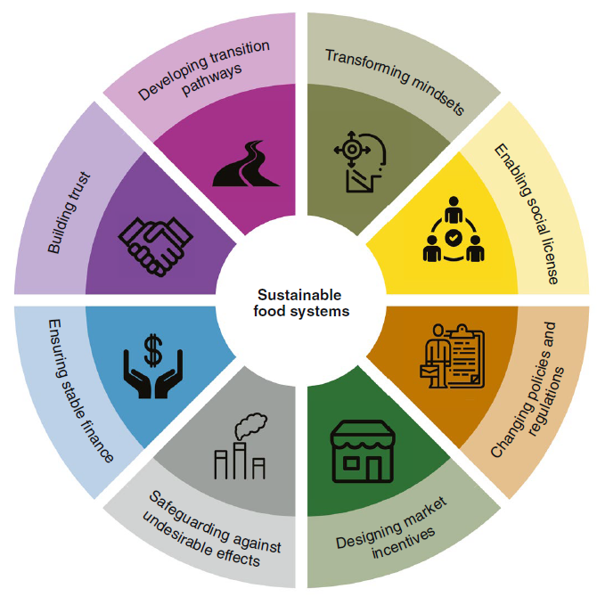
Improve R&D targeting/results
But must address obstacles that make AFS R&D increasingly difficult, costly and mistargeted.
But 35% of >$52bn in 2021 agrifood tech VC funding was e-grocery! Adjust incentives to make solving societal problems financially attractive: advance market commitments, benevolent patent extensions, etc.
Address policy/regulatory obstacles: IP thickets, weak anti-trust enforcement, anti-science movements, etc.
Consider the cautionary tale of Golden Rice vs. earlier generations of IR8/64.
R&D w/o policy/social change underdelivers
(Herrero et al. 2020).

Slide 10

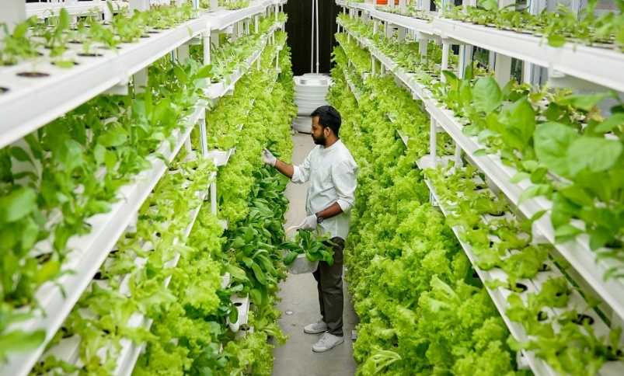
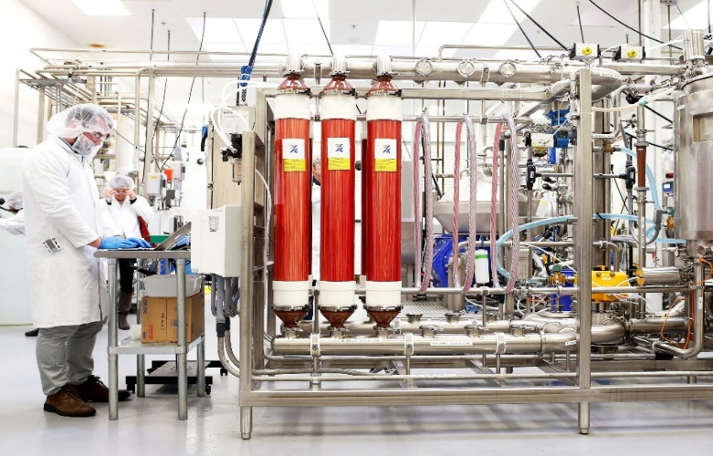
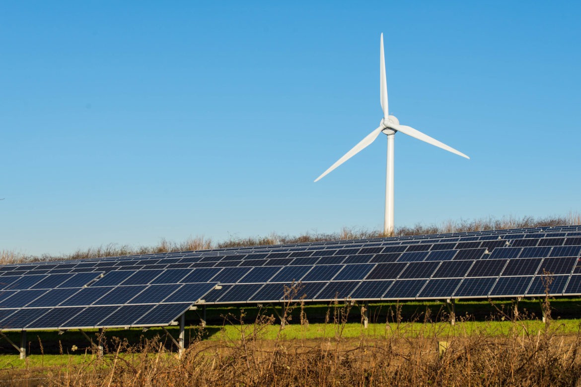
Deagrarianization
Decoupling food production from land is increasingly culturally, economically, technologically feasible. And crucial for climate and infectious disease control.
Photo: Wallace Woon (Straits Times)
Photo: Betterindia.com
Photo: Beck Deifenbach/Reuters
But must manage de-agrarianization’s
creative destruction proactively.
Photo: Gerry Machen/Creative Commons

Slide 11
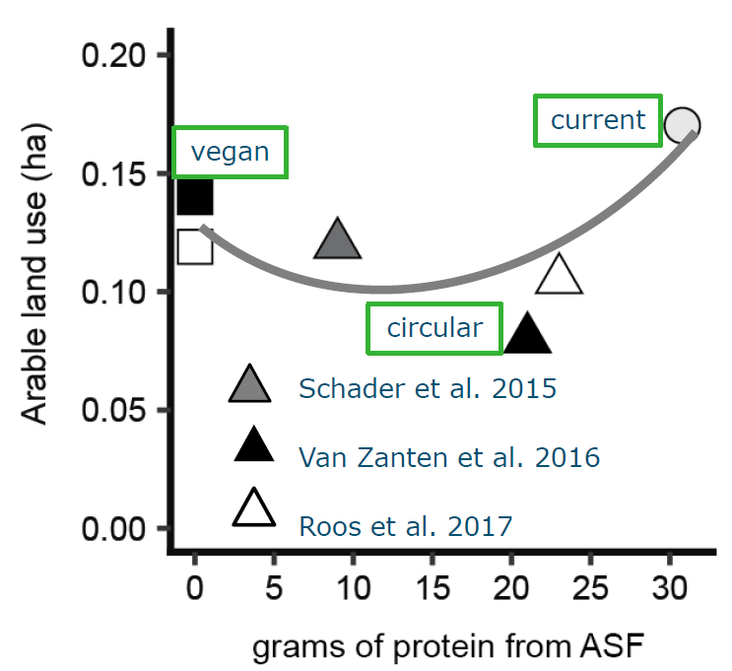
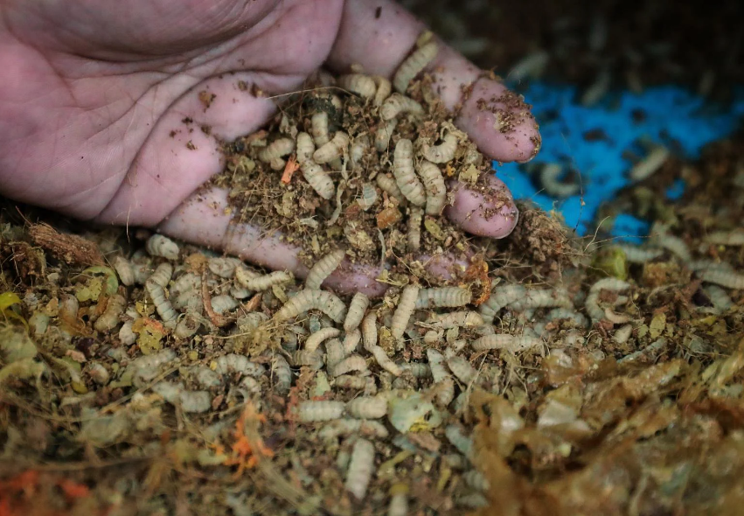
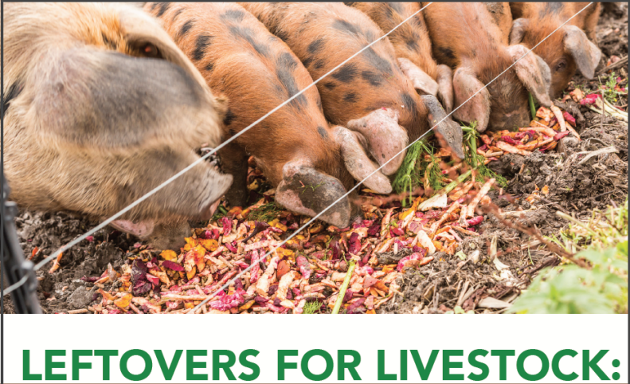
Circularity
We need food to be cheap to meet the needs of the poor. But cheap food results in loss and waste. Recapture the nutrients to help deagrarianize!
Photo: Jason Quah, Straits Times
Source: 2016 Harvard/Food Recovery Project/Arkansas guide
Image: H. Van Zanten
Especially valuable where need to increase ASF intake for health/nutrition. Can maintain 2/3 of current ASF consumption w/o food-feed competition and scale sustainable aquaculture.

Slide 12
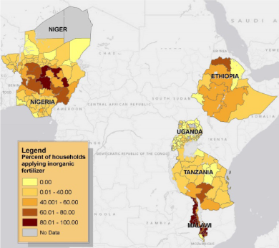
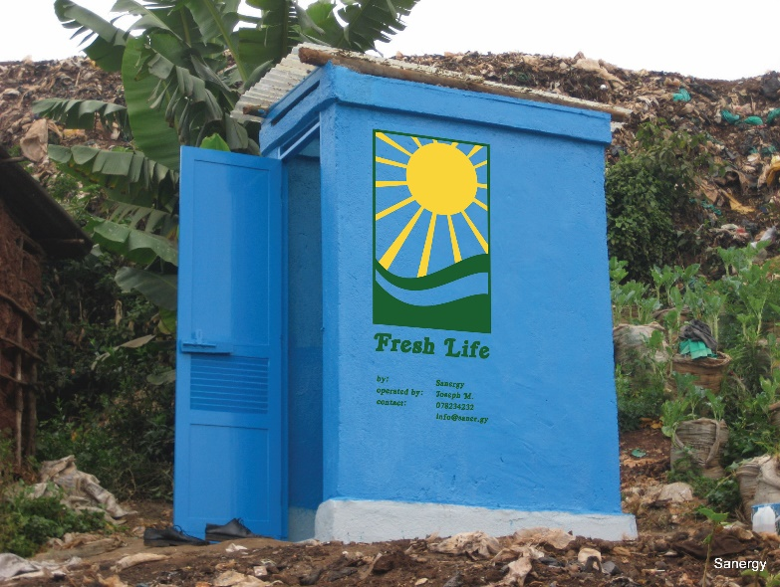
Circularity
Soils degradation hampers productivity growth, esp. in Africa. Modern fertilizers inconsistently used, expensive/imported and vulnerable to disruption.
Source: Sheahan & Barrett FP 2017
Photo: Sanergy
Photo: Andrew Simons et al.
Reduce vulnerability to NPK supply disruption and cost by recycling local wastes.

Slide 13
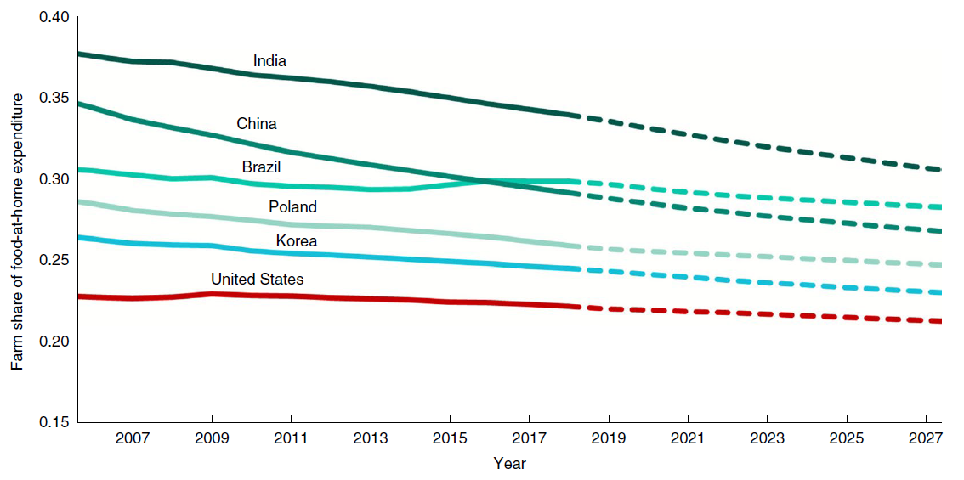
Post-farmgate actors
Most AFS jobs, ultraprocessing/fortification, and value creation (~3/4 globally!) occurs post-farmgate. Big environmental impacts, too. Pay more attention here!
Source: Barrett et al., JEL in press
Source: Yi et al., Nature Food 2021
Consumer non-nutritive food attribute demands increasingly drives upstream production patterns. True cost pricing opportunities exist!
Trust increasingly important … in science, in info, in service providers (regulation, standards, traceability, labeling ever more important)

Slide 14
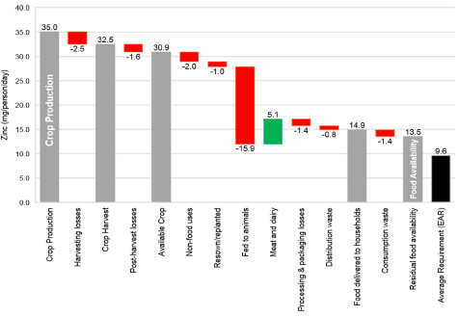
Post-farmgate actors
Especially if one is looking to address food loss and waste, as well as micronutrient losses, value chains are key.
Source: Ritchie et al. 2018 FSFS
For some micronutrients (calcium, folate) residual availability <10% >DRs.

Slide 15

Must consciously bundle
Why socio-technical innovation bundles?
  No magic bullets exist. Multiple constraints in play at once. Relaxing just one limits progress. Must realize synergies to adapt/scale.
  Example: IR8/64 vs. Golden Rice.
Photo credit: IRRI

Slide 16
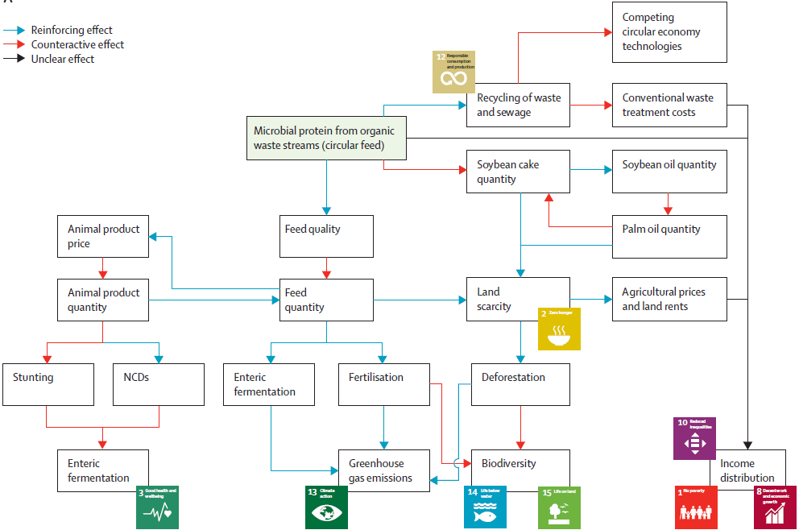
Must consciously bundle
Why socio-technical innovation bundles?
  (2) Must address predicted but unintended consequences. This generates a political economy of opposition due to spillovers and creative destruction. Bundling can build coalitions to overcome incumbent status quo bias
Source: Herrero et al. LPH 2021

Slide 17
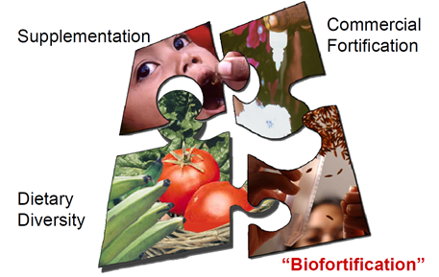
Must consciously bundle
Why socio-technical innovation bundles?
  (3) Heterogeneous needs require bundled solutions
Graphic credit: Ross Welch/Mike Gore
Graphic credit: Ross Welch/Mike Gore

Slide 18
Don’t despair, don’t dally
We face formidable challenges but they are manageable.
We have prevailed before and can again.
Requires (i) a progressive strategy – trust science and support the poor – (ii) focused on a small set of HERS objectives and (iii) operationalized by incentivizing and bundling innovations from varied domains.
Thank you for your time and interest!

